Slide 1
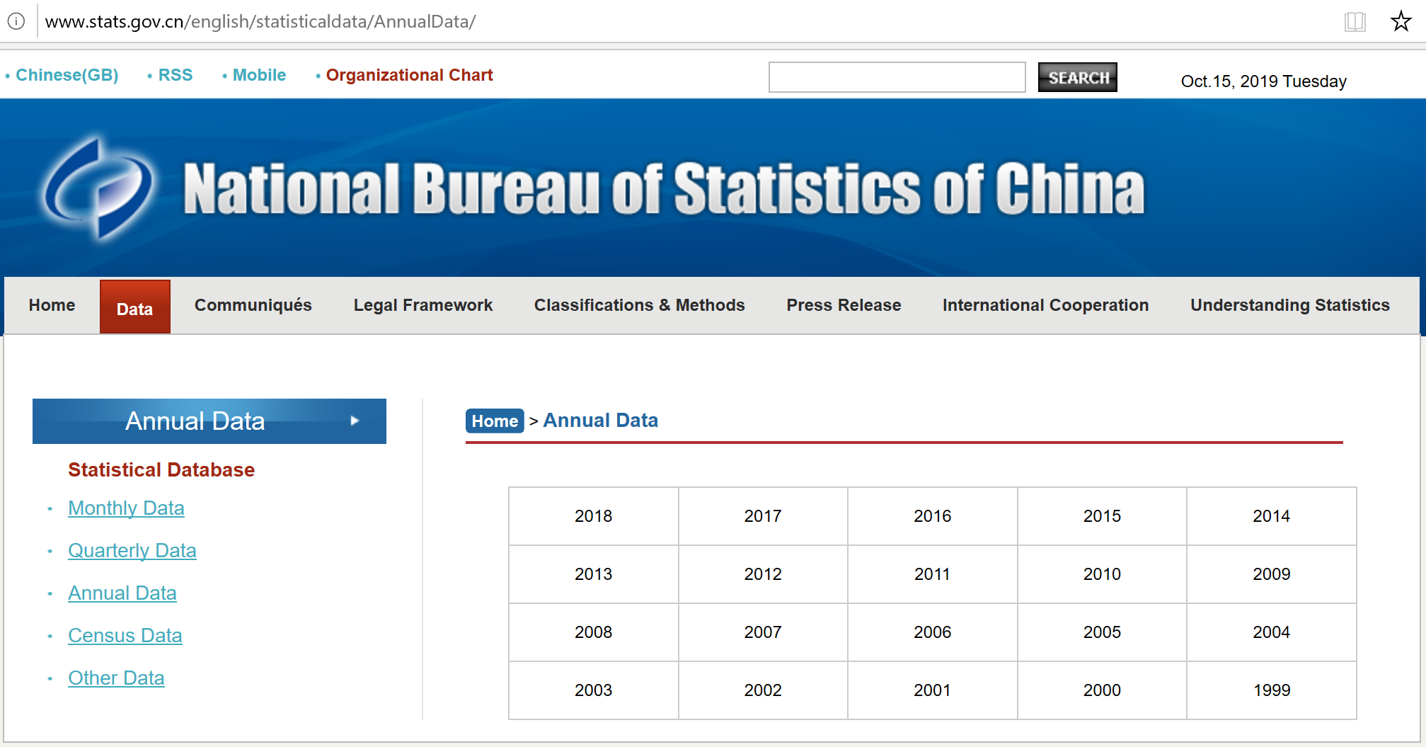
Procedure to obtain PPI data for China
Go to:
Click on the latest year in the table
http://www.stats.gov.cn/english/statisticaldata/AnnualData/

Slide 2
Procedure to obtain PPI data for China
Scroll down and click on “Producer Price Indices for Industrial Products by Sector” in the left menu

Slide 3
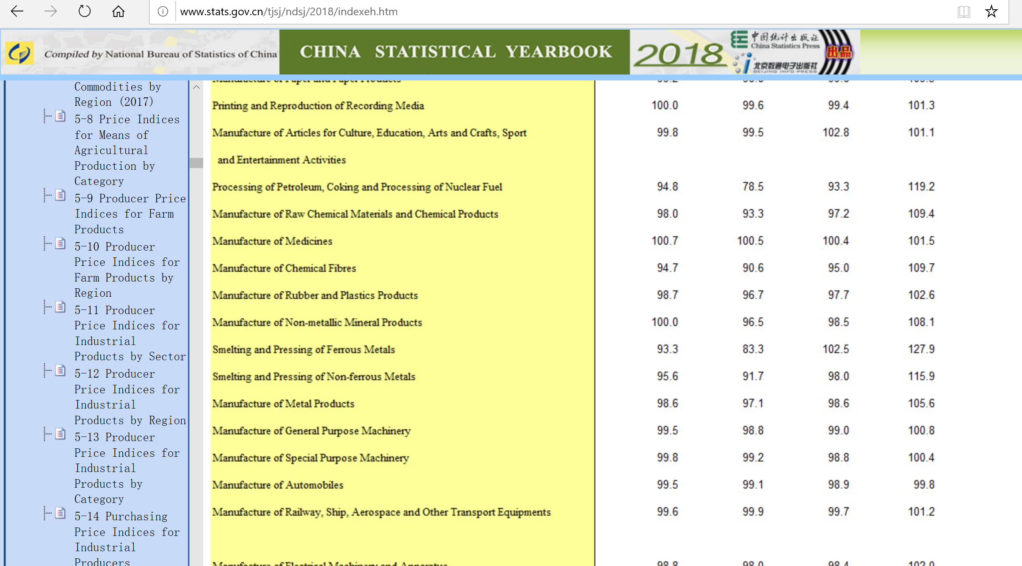
Procedure to obtain PPI data for China
Locate the Sector of interest by scrolling down
The Price Index data is shown in the table on this page.

